Slide 1
MDR October 2023 Diabetes Prediction Model and Data Extraction Pipeline
Muhammad Faisal Shahid

Slide 2
Overview
Recap
Diabetes Survival
Diabetes API
Preprocessing Pipeline

Slide 3
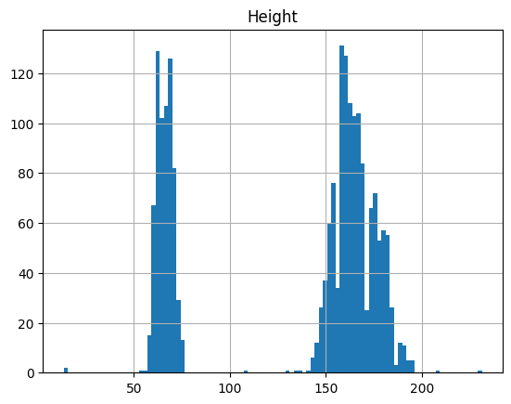
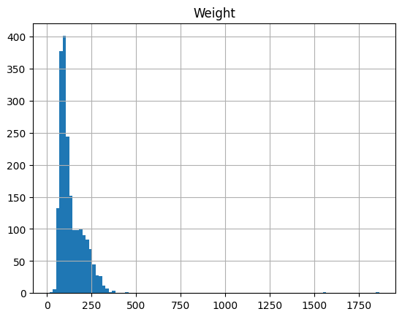
Discrepancy in Vitals

Slide 4
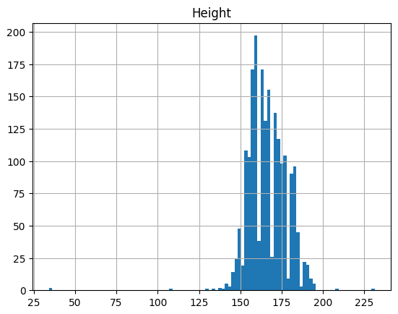
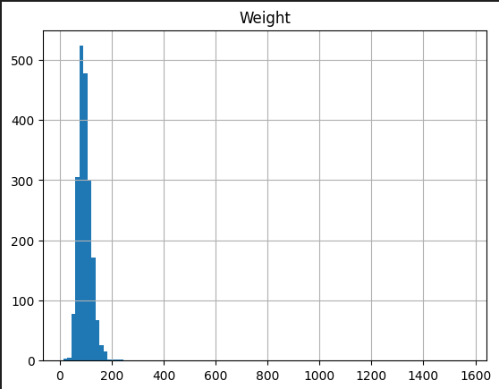
Challenges

Slide 5
Improvements
Modified Features
Gender
Family History
Race Category
Age groups
BMI groups
Dropped Features
Weight
Pulse
New Features
28 Elixhauser comorbidity groups
Height
Blood pressure

Slide 6
Diabetes Survival
12 Months
6 Months
3 Months
1 Month
Diagnosis Date
Earliest Encounter in this window

Slide 7
Diabetes Survival
24 Months
Diagnosis Date
Earliest Encounter in this window

Slide 8
Preprocessing Pipeline
To readily provide the Preprocessed and Cleaned extracted data
Inclusion / Exclusion Criteria, Minimum Encounters and Patient count

Slide 9
Preprocessing Pipeline
Medications:
Medications Names to GPI codes
Prescription:
Medication Quantity
Duplicate Records

Slide 10
Preprocessing Pipeline
Social History:
Smoking Status categories
Alcohol Status categories
Family History:
Diseases Mapping
Family members can be categorize i.e. in Parents, Siblings, Grandparents etc.

Slide 11
Preprocessing Pipeline
Demographics:
Gender discrepancy in value
Marital Status null values
Race/Ethnicity
Surgery History:
Surgery to CPT codes
Surgery Date range

Slide 12
Diabetes API
Input datatypes of API
Race
Gender mapping

Slide 13
Contributions
Diabetes Survival Dataset
Processed Data for 24 months window
Preprocessing Pipeline for predictive modeling
SP4 and SP5 Trainees Evaluations and Projects Guidance

Slide 14
Future Work
Preprocessing pipeline Implementation
Support for Diabetes Pipeline
Patients Journey

Slide 15

Thank you!

